Slide 1
Sigmoid Neurons, Gradient Descent
Prakash P VIT , Chennai

Slide 2
Road Map
Sigmoid Neurons
A typical Supervised Machine Learning Setup
Gradient Descent

Slide 3
Perceptrons to sigmoidal neurons
Enough about boolean functions!
What about arbitrary functions of the form y = f(x) where x ∈ R^{n} (instead of {0, 1}^{n} ) and y ∈R (instead of {0, 1}) ?
Can we have a network which can (approximately) represent such functions ?
have look on perceptrons to sigmoidal neurons ..

Slide 4
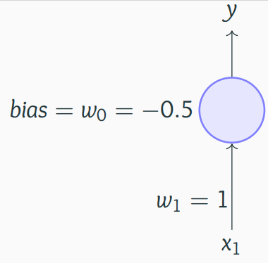
Perceptrons to sigmoidal neurons
A perceptron will fire if the weighted sum of its inputs is greater than the threshold (-w₀)
For example, let us return to our problem of deciding whether we will like or dislike a movie?
Consider that we base our decision only on one input (x1 = criticsRating which lies between 0 and 1)
If the criticsRating = 0.51??
If the movie with criticsRating = 0.49 ??
The thresholding logic used by a perceptron is very harsh !

Slide 5
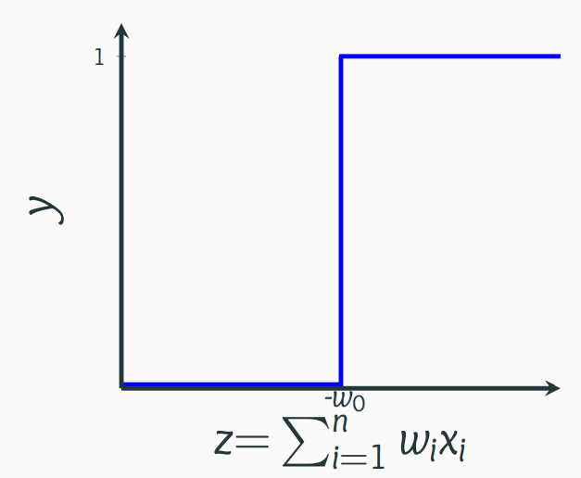
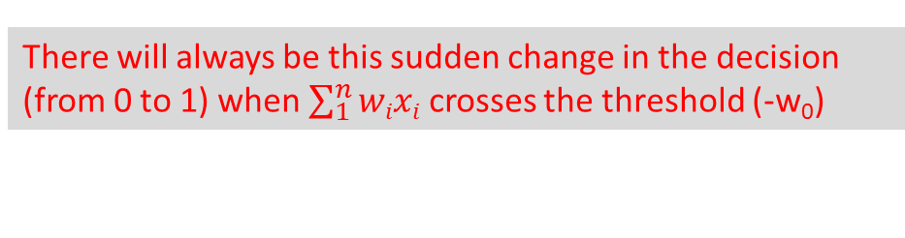
Perceptrons to sigmoidal neurons
This behaviour is not a characteristic of the specific problem we chose or the specific weight and threshold that we chose
It is a characteristic of the perceptron function itself which behaves like a step function
There will always be this sudden change in the decision (from 0 to 1) when $\sum_{1}^{n}{wixi}$ crosses the threshold (-w₀)
For most real world applications we would expect a smoother decision function which gradually changes from 0 to 1

Slide 6
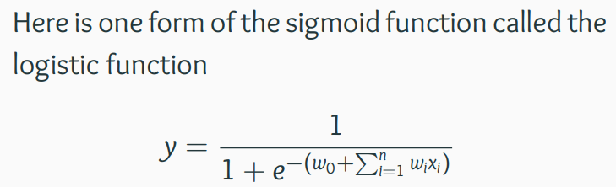
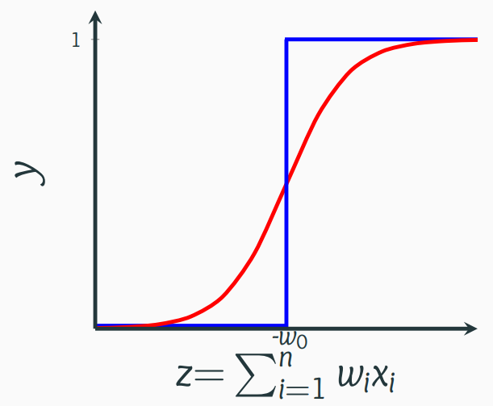
Sigmoid neurons
Introducing sigmoid neurons where the output function is much smoother than the step function
no longer see a sharp transition around the
threshold -w₀
Also the output y is no longer binary but a real value between 0 and 1 which can be interpreted as a probability
Instead of a like/dislike decision we get the probability of liking the movie

Slide 7
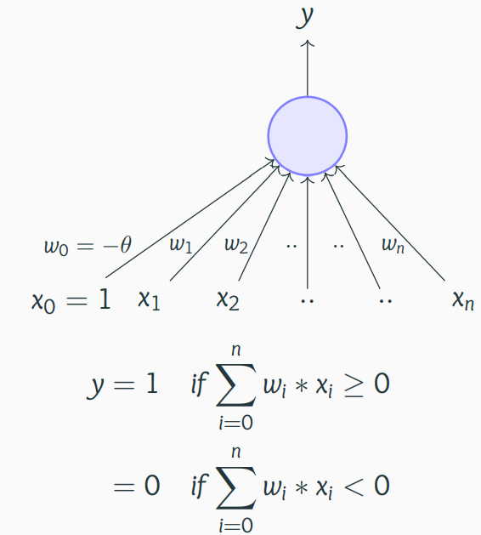
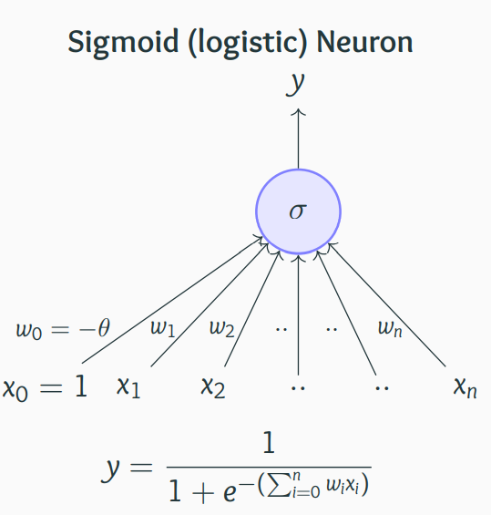
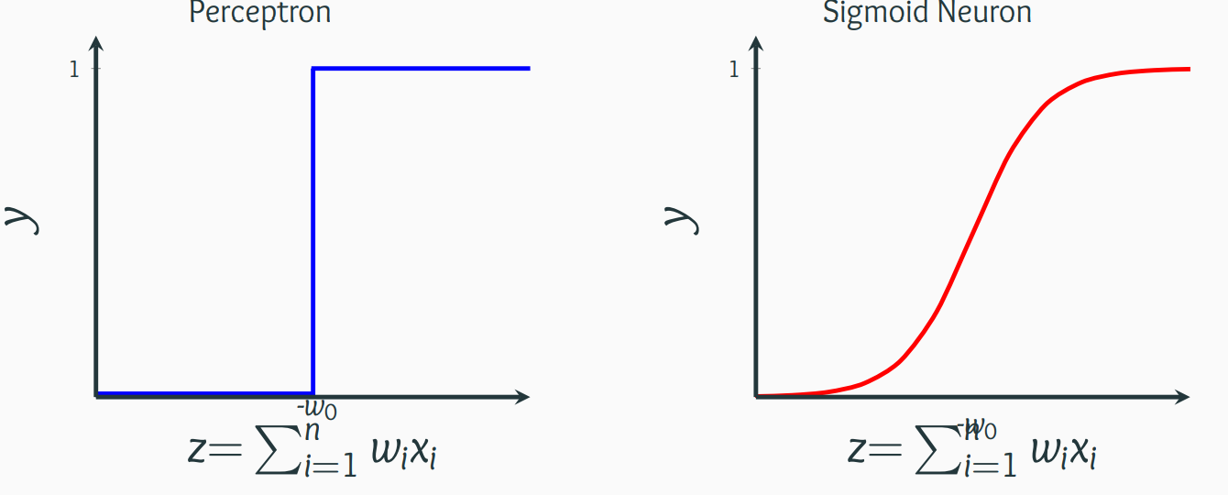
Perceptron Vs Sigmoid neurons
Not smooth, not continuous (at w₀), not differentiable
Smooth, continuous, differentiable

Slide 8
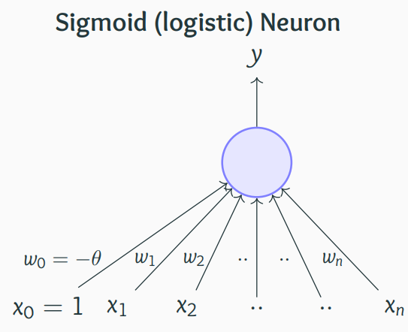
A typical Supervised Machine Learning Setup
Well, just as we had an algorithm for learning the weights of a perceptron, we also need a way of learning the weights of a sigmoid neuron
Before we see such an algorithm we will revisit the concept of error

Slide 9
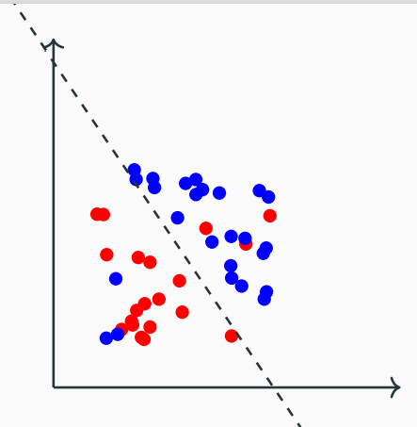
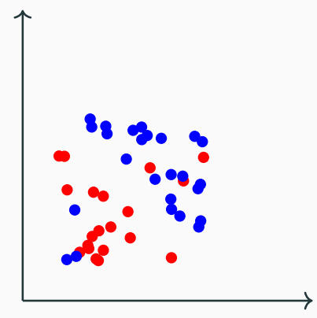
A typical Supervised Machine Learning Setup
Earlier mentioned that a single perceptron cannot deal with this data because it is not linearly separable
What does “cannot deal with” mean?
What would happen if we use a perceptron model to classify this data?
Sure, it misclassifies 3 blue points and 3 red points but we could live with this error in most real world applications
From now on, we will accept that it is hard to drive the error to 0 in most cases and will instead aim to reach the minimum possible error

Slide 10

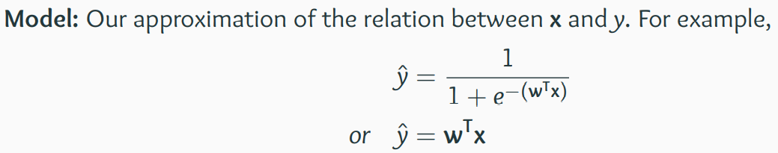
A typical Supervised Machine Learning Setup
Objective/Loss/Error function: To guide the learning algorithm - the learning algorithm should aim to minimize the loss function
Parameters: In all the above cases, w is a parameter which needs to be learned from the data
Learning algorithm: An algorithm for learning the parameters (w) of the model (for
example, perceptron learning algorithm, gradient descent, etc.

Slide 11
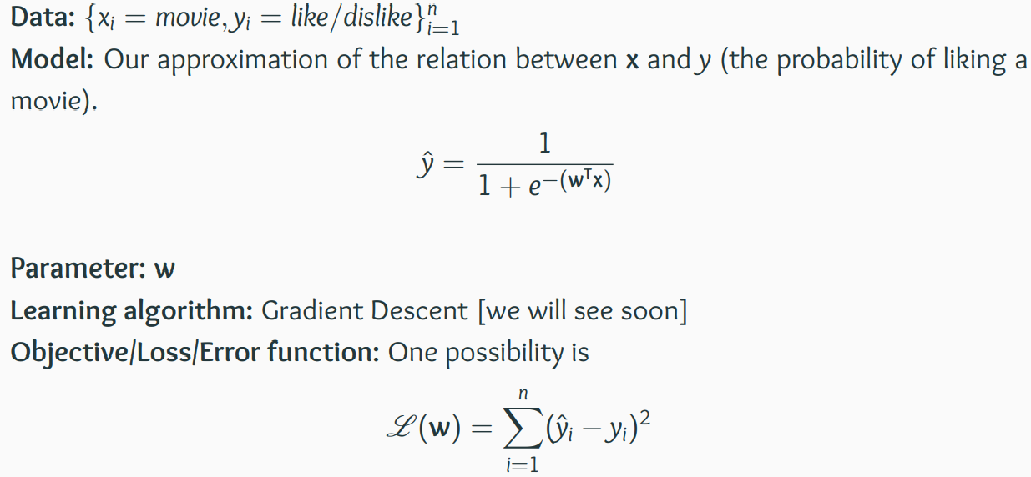
A typical Supervised Machine Learning Setup
Consider our movie example
The learning algorithm should aim to find a w which minimizes the above function
(squared error between y and $\dot{y}$)

Slide 12
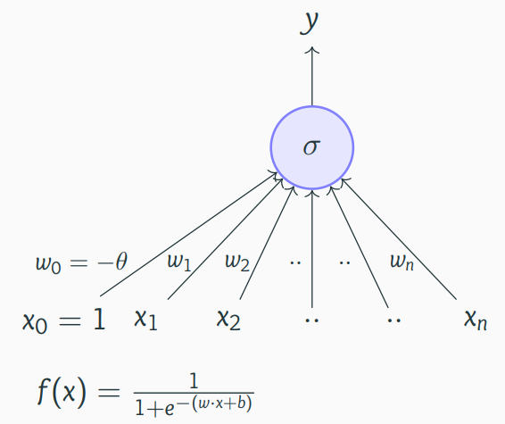
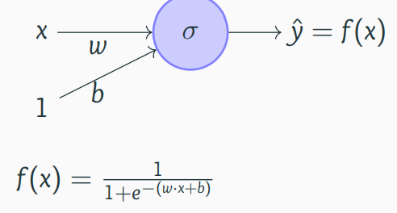
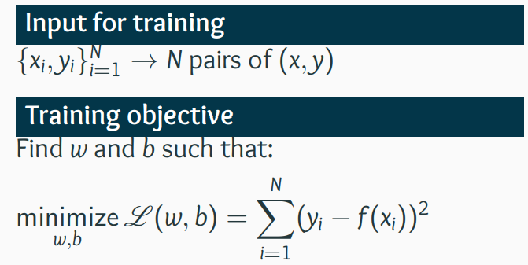
Learning Parameters: (Infeasible) guess work
Keeping this supervised ML setup in mind, we will now focus on this model and discuss an algorithm for learning the parameters of this model from some given data using an appropriate objective function
σ stands for the sigmoid function (logistic function in this case
Consider a very simplified version of the model having just 1 input

Slide 13
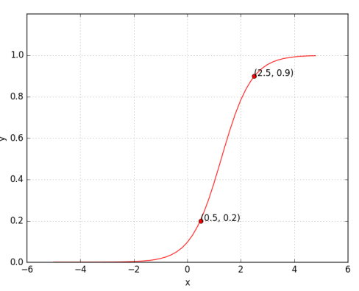
Learning Parameters: (Infeasible) guess work
What does it mean to train the network?
Suppose we train the network with (x, y) = (0.5, 0.2) and (2.5, 0.9)
At the end of training we expect to find w*, b* such that:
f(0.5) → 0.2 and f(2.5) → 0.9

Slide 14
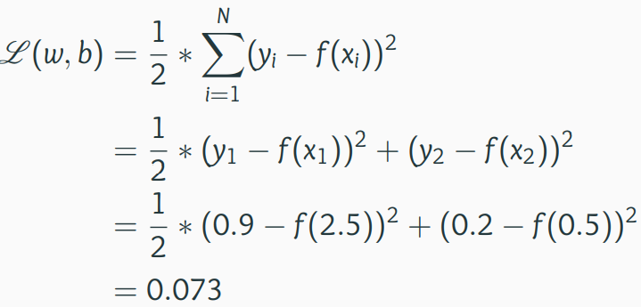
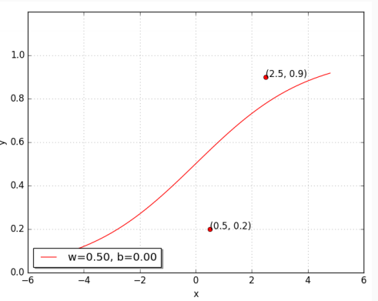
Learning Parameters: (Infeasible) guess work
Can we try to find such a w∗ and b∗ manually
Let us try a random guess.. (say, w = 0.5, b = 0)
Clearly not good, but how bad is it ?

Slide 15
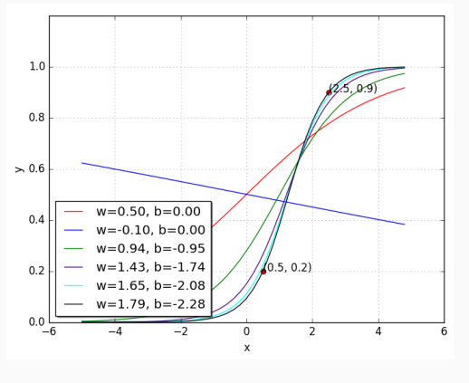
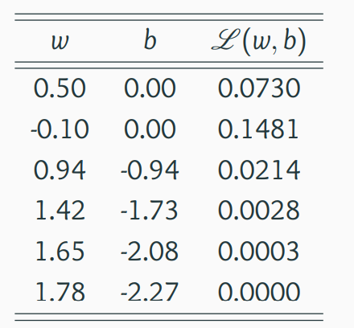
Learning Parameters: (Infeasible) guess work
some guess work and intuition we were able to find the right values for w and b

Slide 16
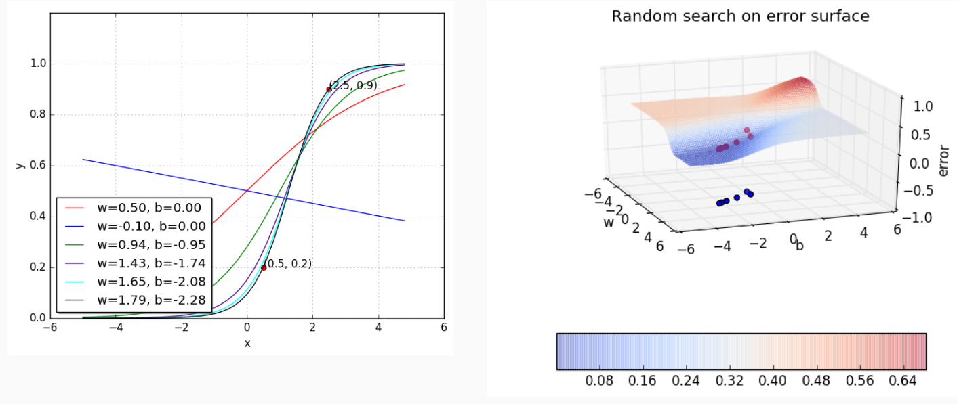
Learning Parameters: (Infeasible) guess work
Let us look at the geometric interpretation of our “guess work” algorithm in terms of this error surface

Slide 17
What's Next
There is a more efficient and principled way of doing the weight calculation →
Learning Parameters : Gradient Descent

Slide 18
References
https://www.cse.iitm.ac.in/~miteshk/CS6910.html#schedule
https://builtin.com/data-science/gradient-descent
https://www.khanacademy.org/math/multivariable-calculus/applications-of-multivariable-derivatives/optimizing-multivariable-functions/a/what-is-gradient-descent

Slide 19
Thanks

